Slide 1
2020 MMILAB.ML Seminar Week1(8/1~8/10)
20151415 김성수

Slide 2
Contents
Supervised classifier
- K-NN(K-Nearest-Neighbor)
- SVM(support vector machine)

Slide 3
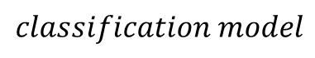
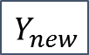
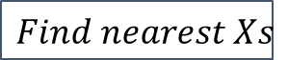
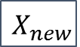

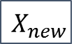
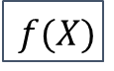
Classification model
1. Model -based learning
- Linear/nonlinear model (linear regression, logistic regression)
- Neural network
- Decision tree
- Support vector machine
2. Instance - based learning
K- nearest neighbor
$X_{new}$
$$f(X)$$
$Y_{new}$
$$classification model$$
$X_{new}$
$$Find nearest Xs$$
$Y_{new}$

Slide 4
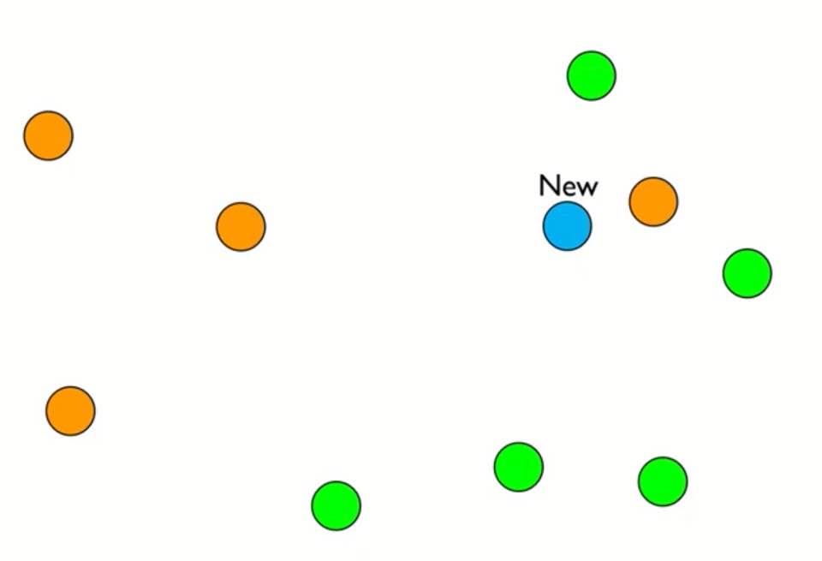
Nearest neighbor
• 3 nearest neighbor
2
1
3
Majority voting from
nearest neighbor data

Slide 5
Property of KNN algorithm
Instance(sample)-based learning
Memory-based learning
Lazy learning

Slide 6
KNN hyper parameter
Number of K
Distance measure

Slide 7
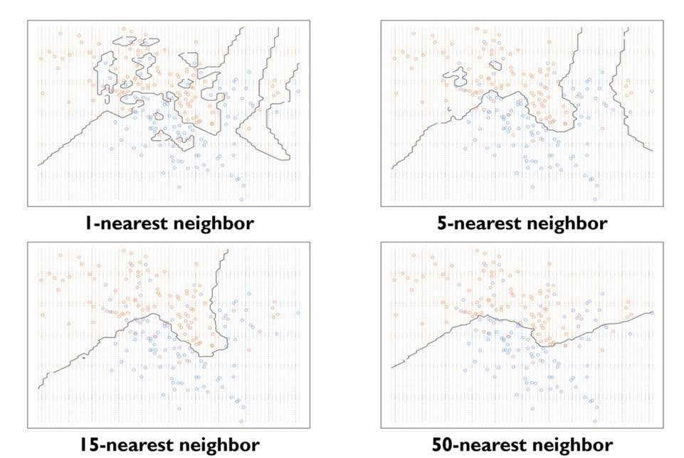
Hyper parameter : K
When K is too small
: Overfitting
->Get too much local property for each data
When K is too big
: Underfitting
->Miss classification

Slide 8
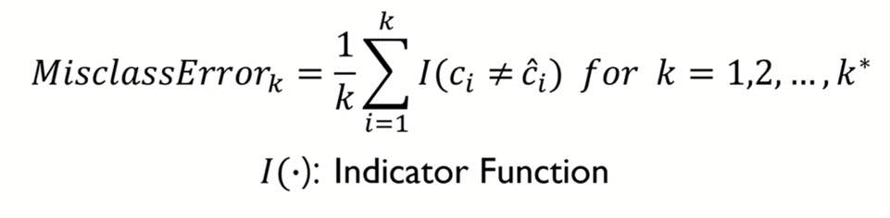
Hyper parameter : K
How to select proper K?
True
Prediction

Slide 9
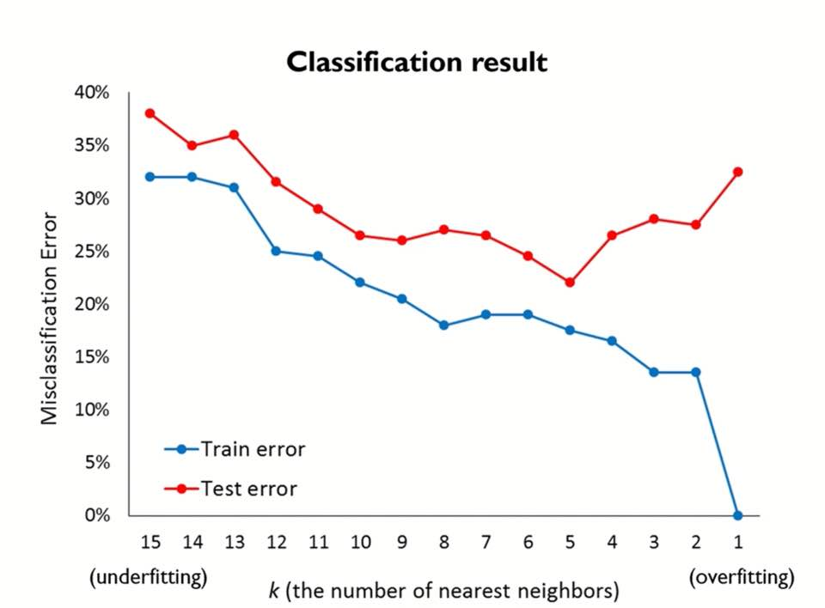
Hyper parameter : K
How to select proper K?

Slide 10
Hyper parameter : Distance measure
Various distance measurement
: ex) Euclidean distance, Correlation distance…
Why is it important to choose distance measure?
: Each data has different unit(and also range, variance..) of value (ex:Height(1.5~1.8m),Weight(50~80kg)…)
Certain data can be dominant when measuring distance
Normalization requires

Slide 11
Hyper parameter : Distance measure
•Euclidean distance
•Mahalanobis distance
•Correlation distance
- Pearson correlation
- Spearman rank correlation

Slide 12
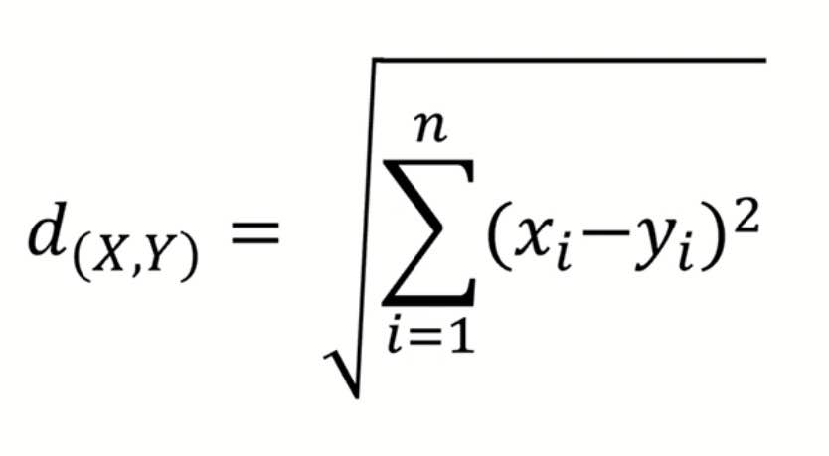
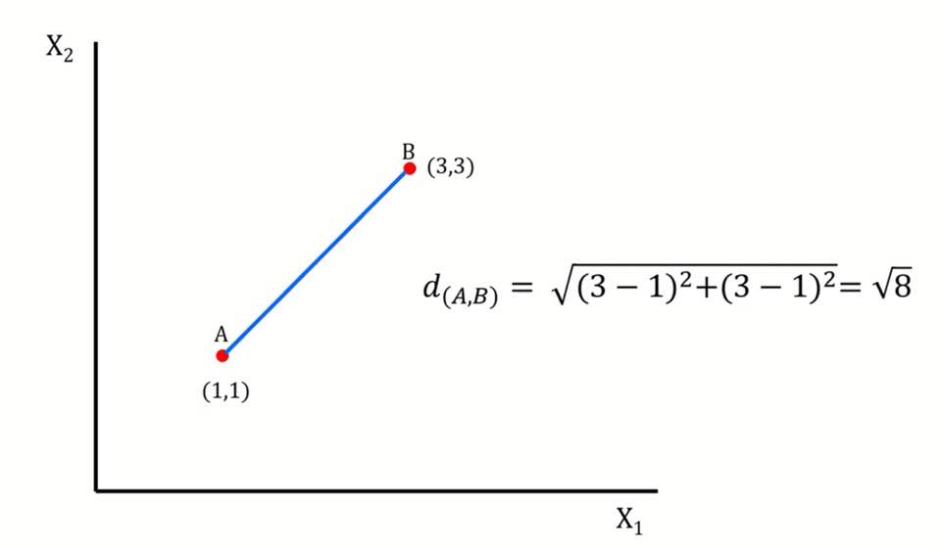
Hyper parameter : Distance measure
•Euclidean distance

Slide 13
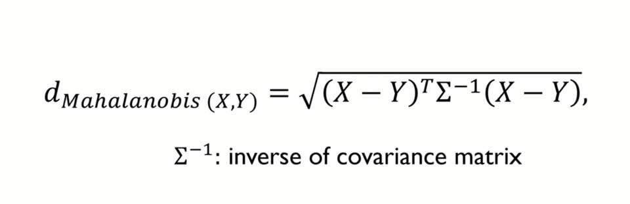
Hyper parameter : Distance measure
•Mahalanobis distance
Include variance of each data, and covariance between datas.
If covariance matrix is identity matrix → Mahalanobis distance = Euclidean distance

Slide 14
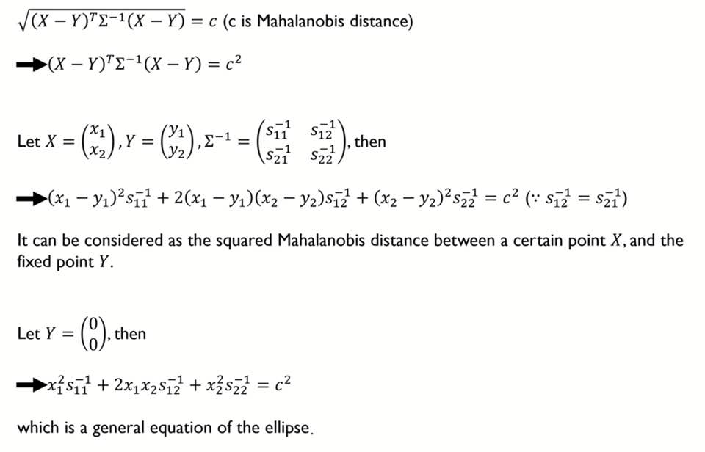
Hyper parameter : Distance measure
•Mahalanobis distance

Slide 15
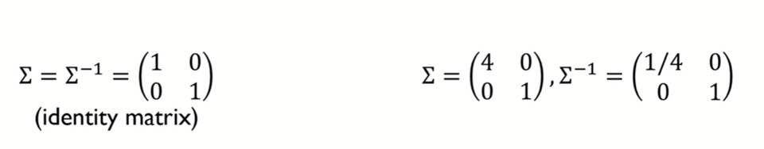
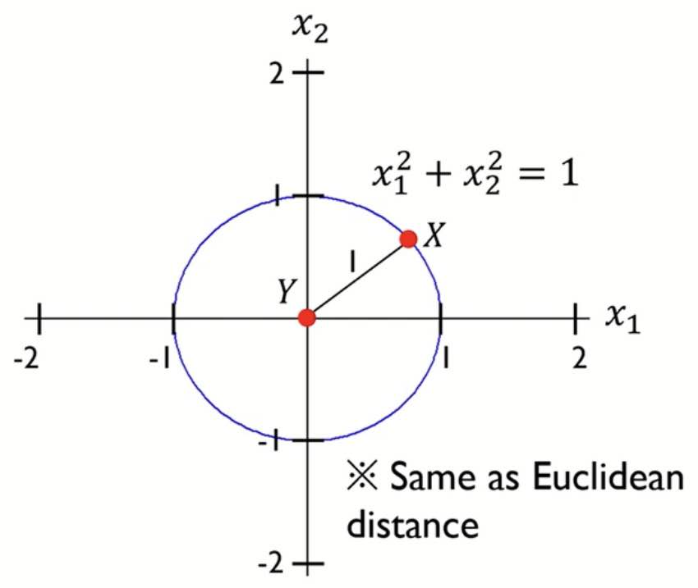
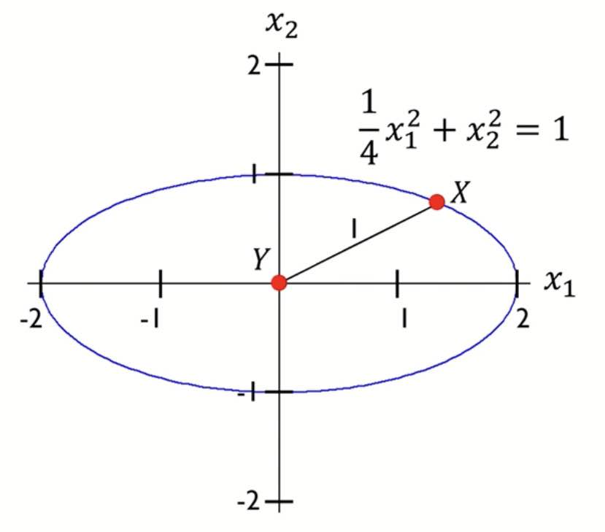
Hyper parameter : Distance measure
•Mahalanobis distance

Slide 16
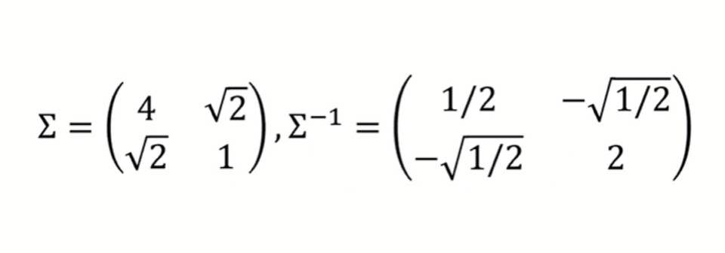
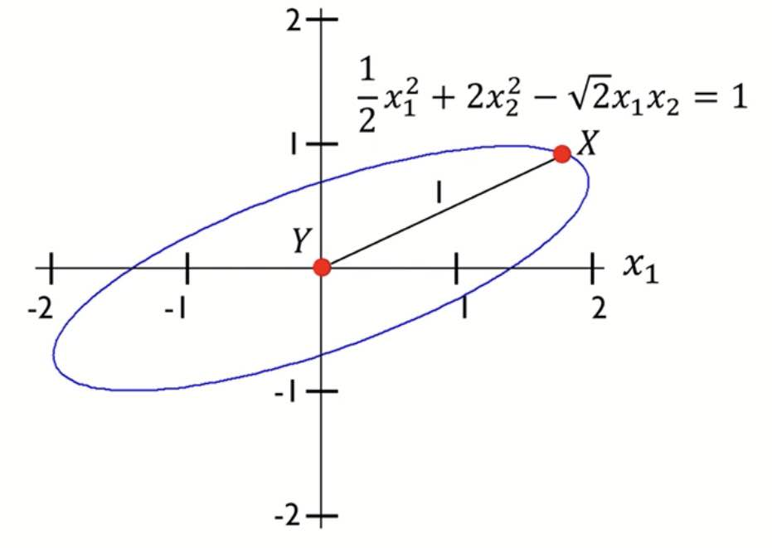
Hyper parameter : Distance measure
•Mahalanobis distance

Slide 17
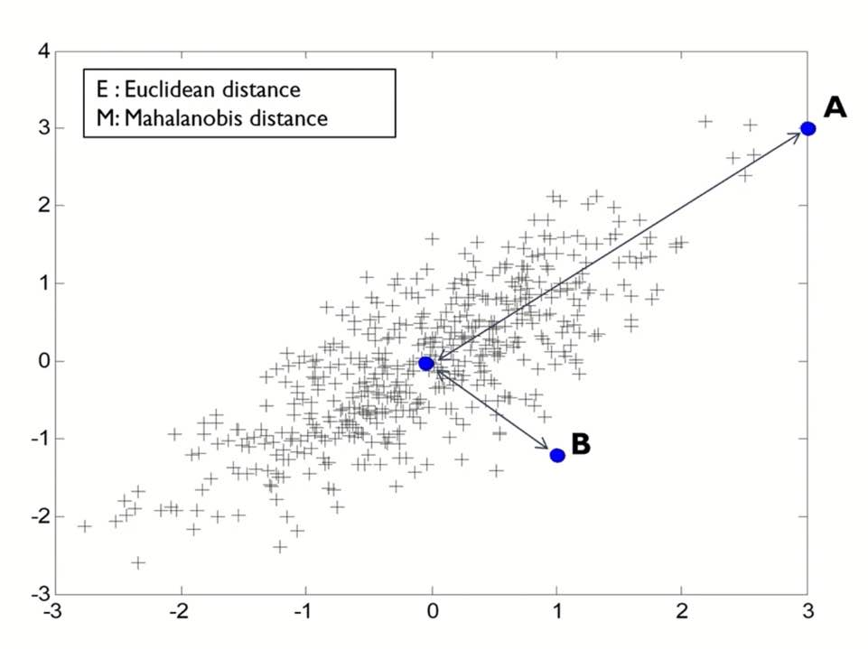
Hyper parameter : Distance measure
•Mahalanobis distance
x2
correlation
Euclidean:4.3
Mahalanobis:3.4
Euclidean:1.6
Mahalanobis:3.7
x1

Slide 18
Pros and cons of KNN algorithm
•Pros
- Robust to noise. (Especially when using Mahalanobis distance)
- Efficient when training data is large.
•Cons
- Need to change hyper parameter empirically.
- Computationally expensive.

Slide 19
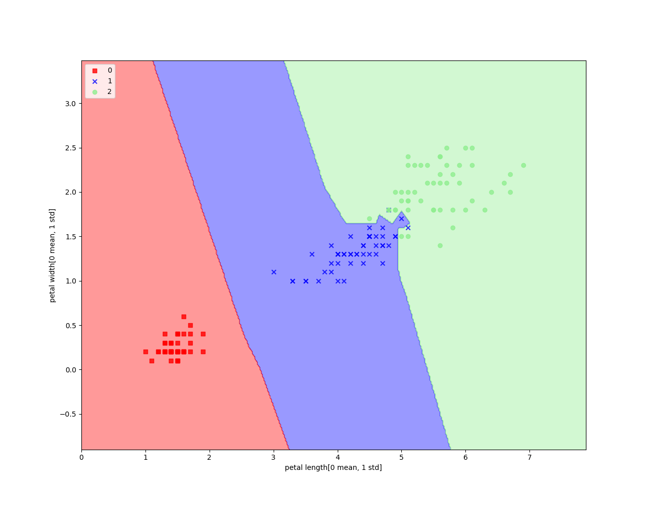
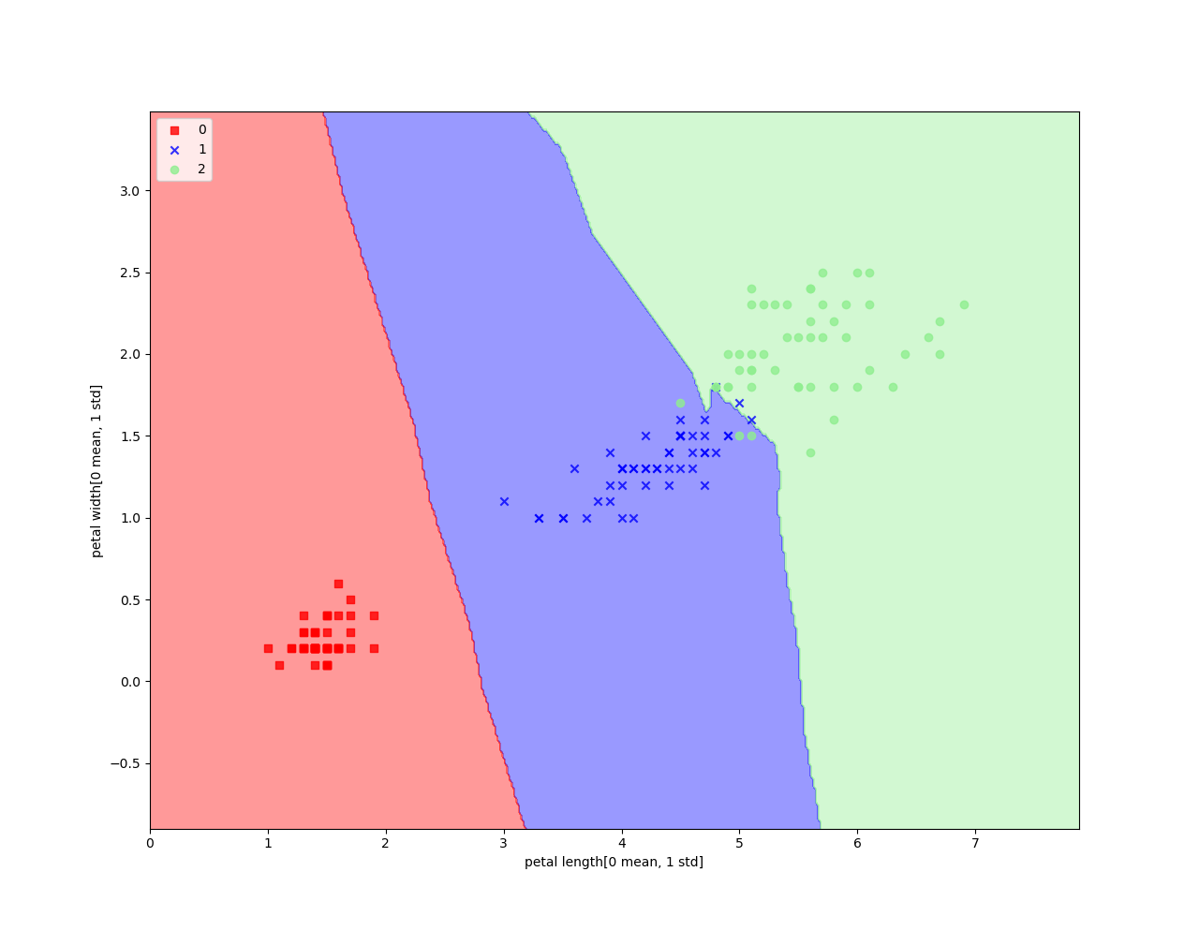
KNN result (Iris data set, Euclidean distance)
k =1
k =5

Slide 20
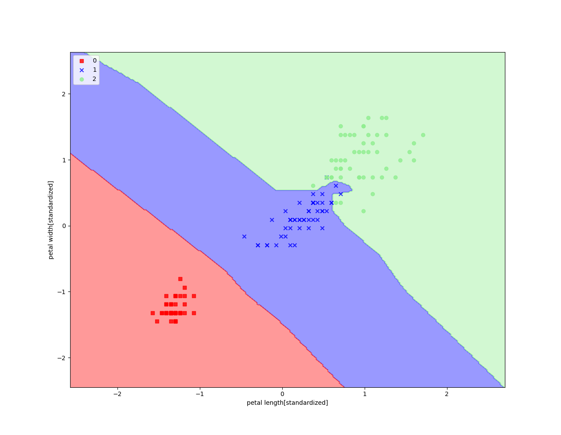
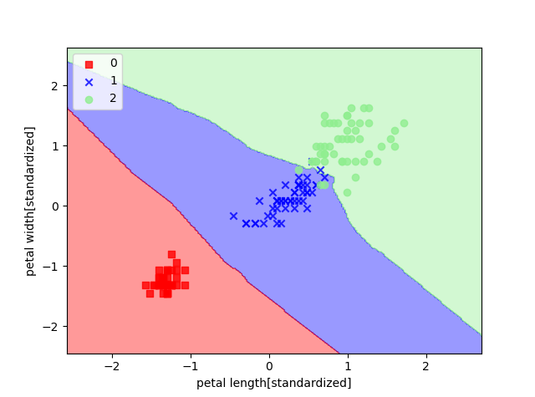
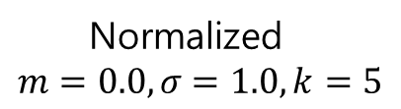
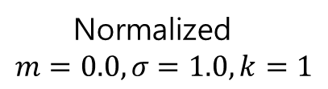
KNN result (Iris data set, Euclidean distance)
Normalized
$$m=0.0, σ=1.0,k=1$$
Normalized
$$m=0.0, σ=1.0,k=5$$

Slide 21
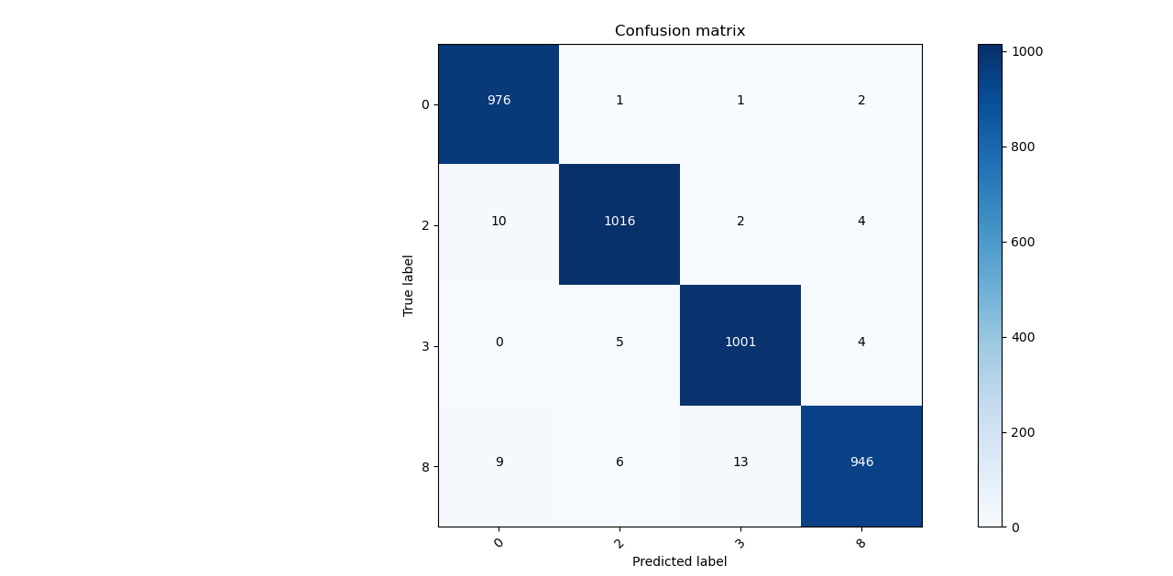
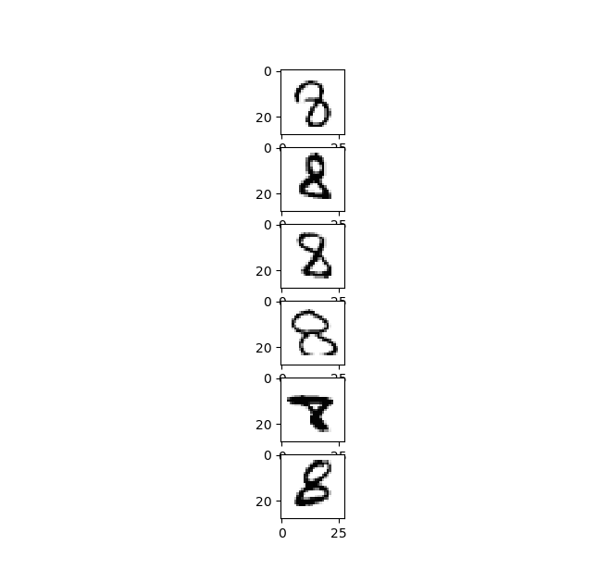

KNN result (MNIST data set)
$$k =3$$
Pred 2, True =8

Slide 22
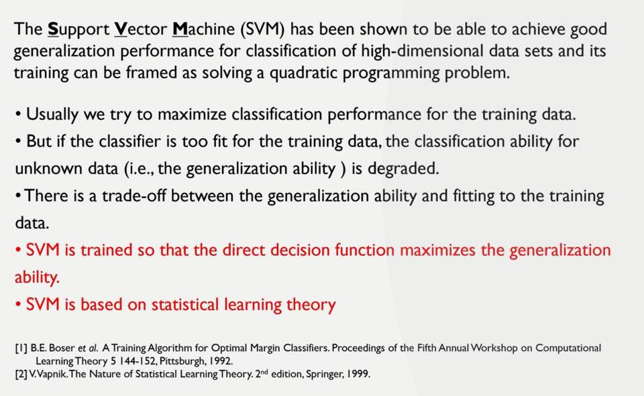
Support Vector Machine(SVM)

Slide 23
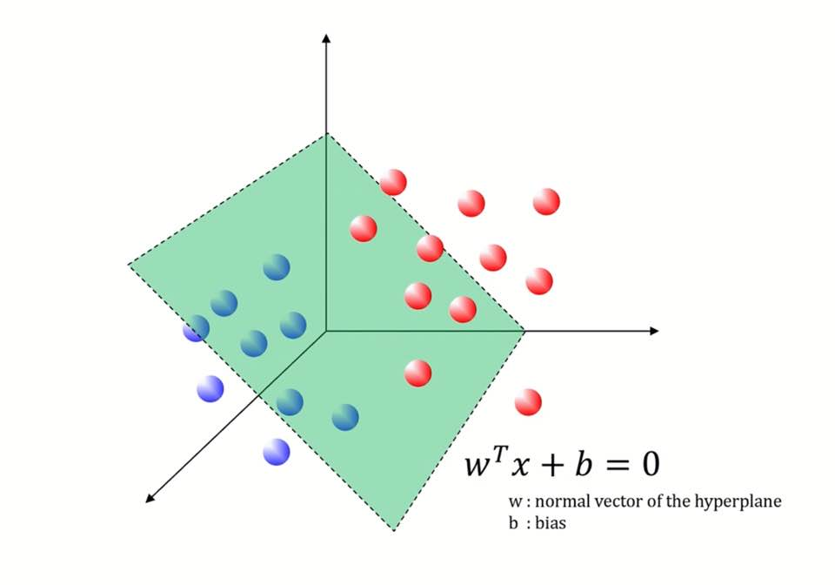
Support Vector Machine(SVM)
Ex)3 dimensional data set classification

Slide 24
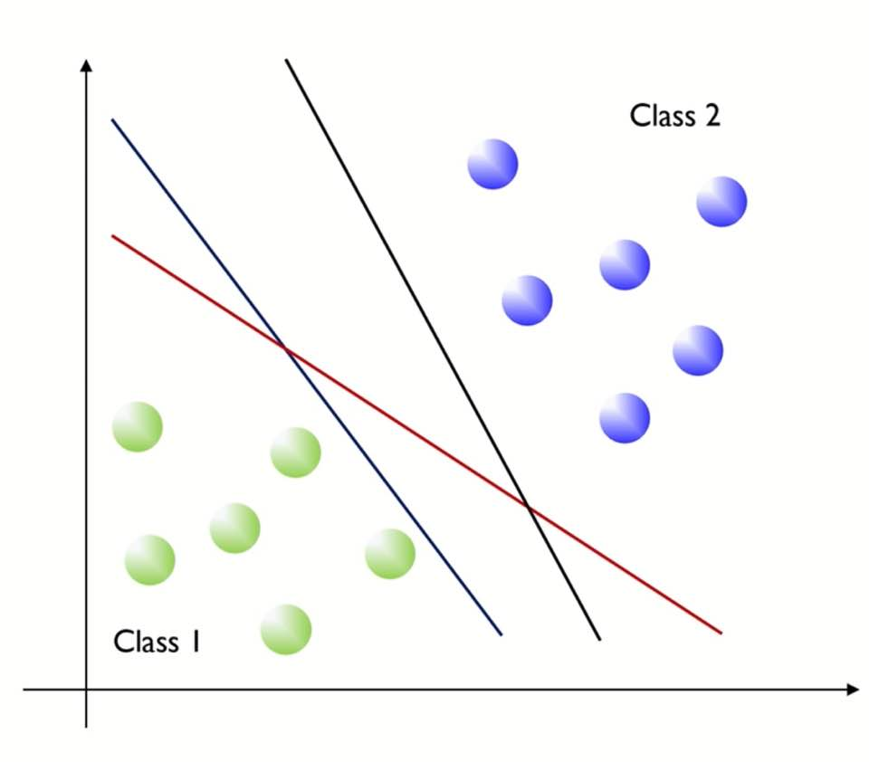
Support Vector Machine(SVM)
There are lots of hyper plane which can classify two classes
Which is better among them?
What is the condition for better hyperplane?
-> Maximizing margin over the training set
= Minimizing generalization error
= Good prediction performance

Slide 25
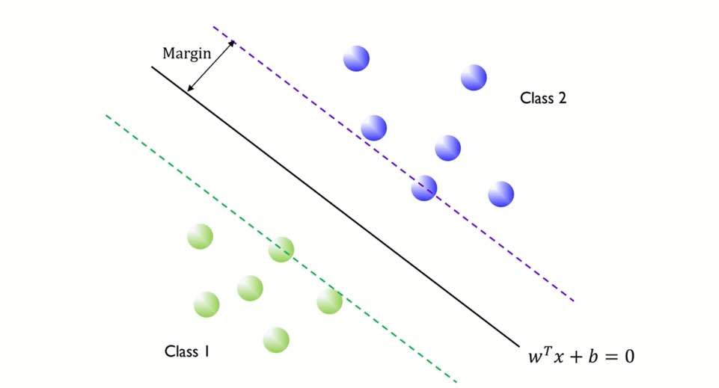
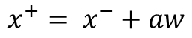
Support Vector Machine(SVM)
•Geometric margin
$$x^{+}= x^{−}+aw$$
Margin can be represented with vector w.

Slide 26
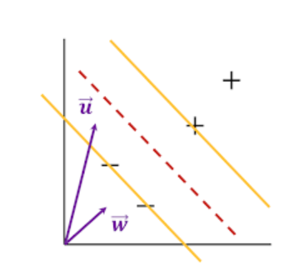
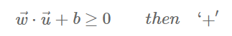
Support Vector Machine(SVM)
•Decision rule
Inner product of arbitrary u and w

Slide 27
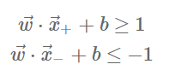
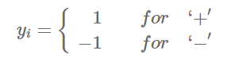
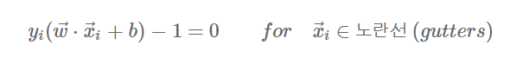
Support Vector Machine(SVM)
•Additional constraint
Equality condition

Slide 28
Support Vector Machine(SVM)
•Additional constraint
Equality condition

Slide 29
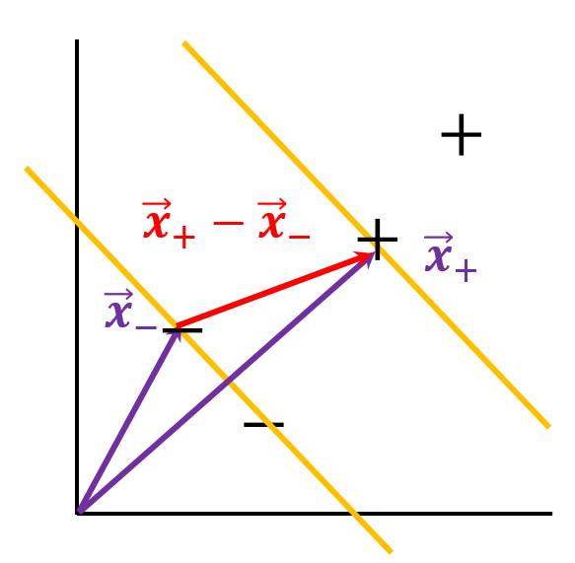
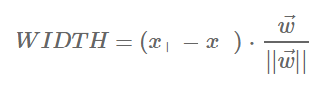
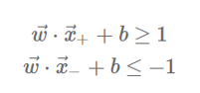
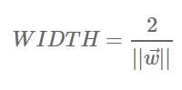
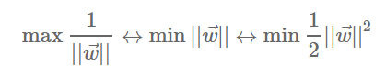
Support Vector Machine(SVM)
•Maximizing margin
From equality condition
What we should maximize

Slide 30
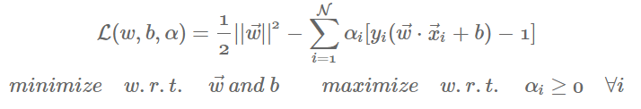
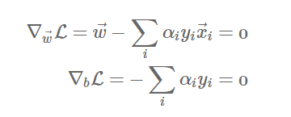
Support Vector Machine(SVM)
•Optimizing technique -> Lagrange multiplier method
α= Lagrange muliplier

Slide 31
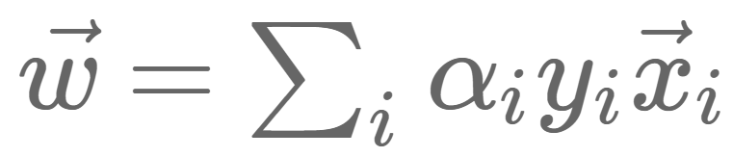
Support Vector Machine(SVM)
•Optimizing technique -> Lagrange multiplier method
Decision vector w = Linear sum of ‘some’ sample vector
α is 0 when sample vector is not on the boundary.

Slide 32
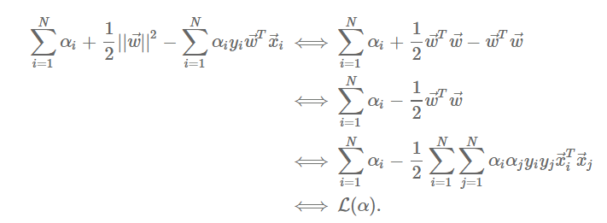
Support Vector Machine(SVM)
•Optimizing technique -> Lagrange multiplier method
α
We can get α from this equation

Slide 33
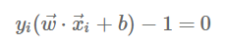
Support Vector Machine(SVM)
•Optimizing technique -> Lagrange multiplier method
We can get α from this equation
We can get w from this equation
We can get b from this equation

Slide 34
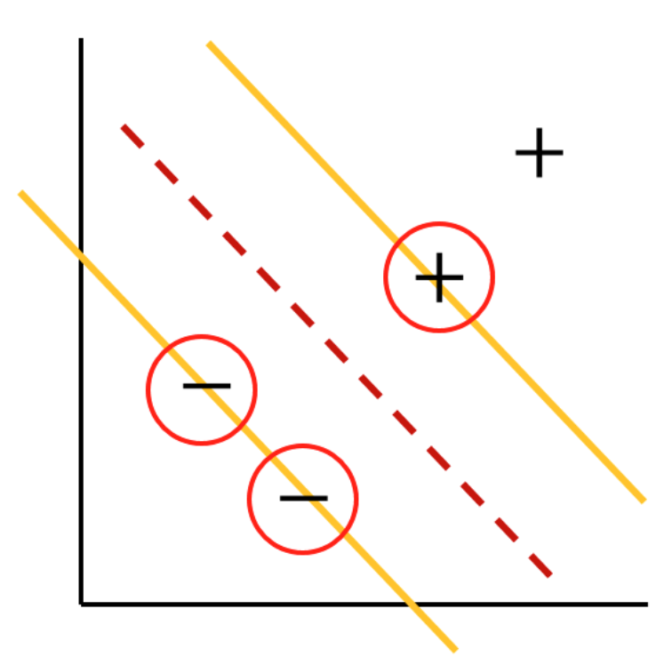
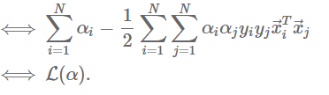
Support Vector Machine(SVM)
• Meaning of support vector
Support vector = Sample vector which has nonzero α
Linear term + quadratic term for α
-> We don’t have to worry about local minima
-> Convex optimization(=only one max , min value)
-> Globally optimal solution exists
Support vector always determines optimal decision boundary

Slide 35

Support Vector Machine(SVM)
• Kernel methods for nonlinear classification

Slide 36


Support Vector Machine(SVM)
• Transforming data

Slide 37

Support Vector Machine(SVM)
• Example

Slide 38



Support Vector Machine(SVM)
•Kernel mapping

Slide 39

Support Vector Machine(SVM)
•Kernel mapping
We can get same result by defining kernel function about inner product
-> We don’t need to transform data

Slide 40


Support Vector Machine(SVM)
•Example

Slide 41

Support Vector Machine(SVM)
•Kernel functions

Slide 42




Support Vector Machine(SVM)
•Nonlinear SVM using Kernel functions
$$Kernel(x,y)={(xy+1)}^{2}$$

Slide 43

Support Vector Machine(SVM)
•Nonlinear SVM using Kernel functions
$$Kernel(x,y)={(xy+1)}^{2}$$

Slide 44



SVM result (Iris data set)
Linear classification
Nonlinear classification
Gamma = 0.2
Nonlinear classification
Gamma = 50
※ Gamma = cut-off parameter

Slide 45




SVM result (MNIST data set)
$$k =3$$
$$Pred= 2, True=8$$

Slide 46


Decision tree result (Iris,MNIST data set)

Slide 47
THANK YOU for your attention

